Slide 1
Citi Bike Leaflet and Introduction to Projects
Lesson 17.3
Notes:
1.1

Slide 2

Class Objectives
By the end of today’s class you will be able to:
Gain a Leaflet mastery by completing an in-class project.
Form project 2 teams and draft project 2 proposals.
Notes:
1.1

Slide 3


UPCOMING CAREER SERVICES
Confidential & Proprietary Information of Trilogy Education Services, a 2U, Inc. brand © Trilogy Education Services, a 2U, Inc. brand

Slide 4


Raise your hand if you want a new job or a promotion?
Confidential & Proprietary Information of Trilogy Education Services, a 2U, Inc. brand
© Trilogy Education Services, a 2U, Inc. brand

Slide 5





Confidential & Proprietary Information of Trilogy Education Services, a 2U, Inc. brand
Why Discuss Career Services Now?
In the next few weeks, you will complete a Career Services Preferences survey on BootcampSpot
The options available:
Information about online career events and workshops
Access to JobTrack, a job search management tool
Feedback on your professional materials from your Profile Coach - Resume, Github, LinkedIn, etc.
1:1 scheduled career coaching sessions with your Career Director at least twice a month, OR a Career Director you can reach out to when you have questions
© Trilogy Education Services, a 2U, Inc. brand

Slide 6
Confidential & Proprietary Information of Trilogy Education Services, a 2U, Inc. brand
First Step: Becoming Employer Ready
You MUST HAVE polished professional materials to begin applying for jobs
REVIEW MILESTONE 1 Employer Ready vs. Employer Competitive for a refresher Once you are Employer Ready, you’ll unlock access to additional Career Services support
SMALL GROUP TECHNICAL INTERVIEW WORKSHOPS Within one 90-minute session, 50% of students increase their scores by 50% on technical assessments.
JOB REFERRALS We have a network of employers who regularly partner with us to hire tech talent. While we cannot guarantee a referral, you can only be referred when you are Employer Ready.
© Trilogy Education Services, a 2U, Inc. brand

Slide 7

Confidential & Proprietary Information of Trilogy Education Services, a 2U, Inc. brand
Introduction to Career Services
© Trilogy Education Services, a 2U, Inc. brand

Slide 8
Confidential & Proprietary Information of Trilogy Education Services, a 2U, Inc. brand
Working With Your Career Director
Your Career Director provides you with 1:1 coaching to help you be Employer Competitive in your job search.
Topics include: Applying, gaining traction to land interviews, conducting mock interviews, networking, salary negotiation, motivation and more!
YOU HAVE TWO OPTIONS
1
1:1 scheduled bi-monthly recurring coaching calls
2
Reaching out to your Career Director when needed
We recommend scheduled Recurring Calls - Why?
The data shows that our students who are Employer Ready and participate in recurring calls are MUCH MORE LIKELY to secure the jobs they want
© Trilogy Education Services, a 2U, Inc. brand

Slide 9
Confidential & Proprietary Information of Trilogy Education Services, a 2U, Inc. brand
Career Services Next Steps
1
Visit the Career Services page on BootcampSpot for resources on developing your Employer Ready professional materials
Submit your professional materials for review. You’ll receive feedback from your Profile Coach within 5 days.
Be on the lookout for an email from your Career Director inviting you to schedule your first coaching call in the next few weeks
Ready to meet with your Career Director now? They’ve sent you multiple emails throughout the course - respond to an email to get connected!
Register for Career Service events and workshops
2
3
© Trilogy Education Services, a 2U, Inc. brand

Slide 10
Introduce Citi Bike
Introduce Citi Bike
Notes:
1.2

Slide 11
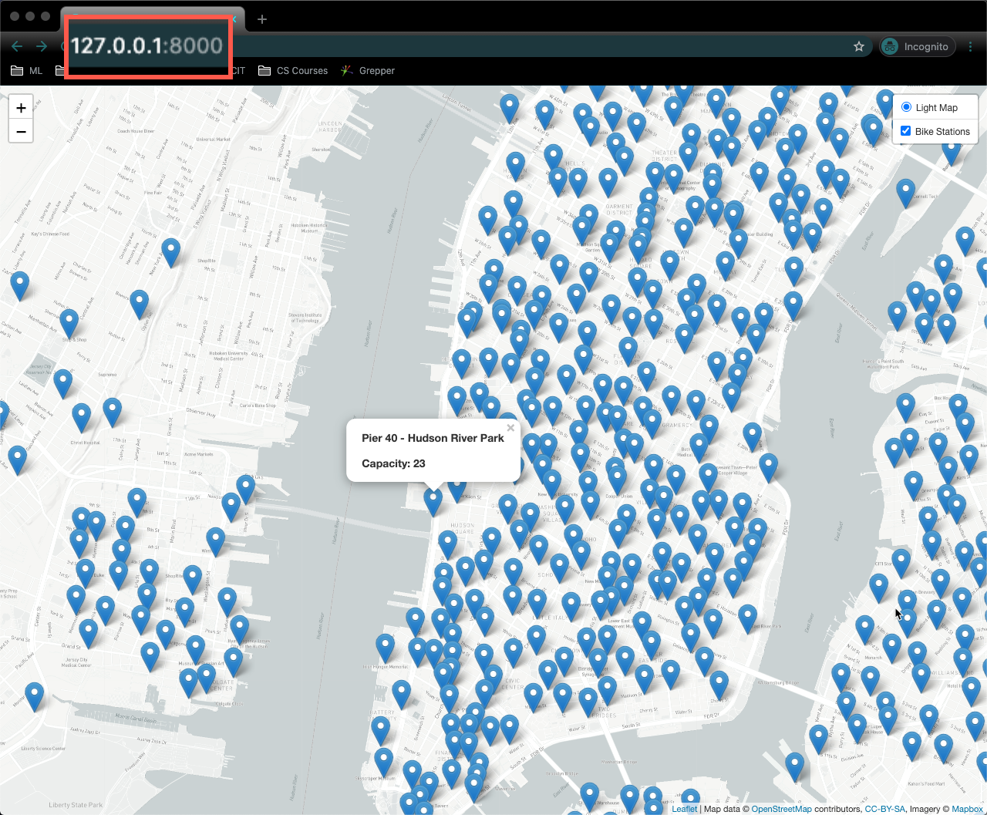
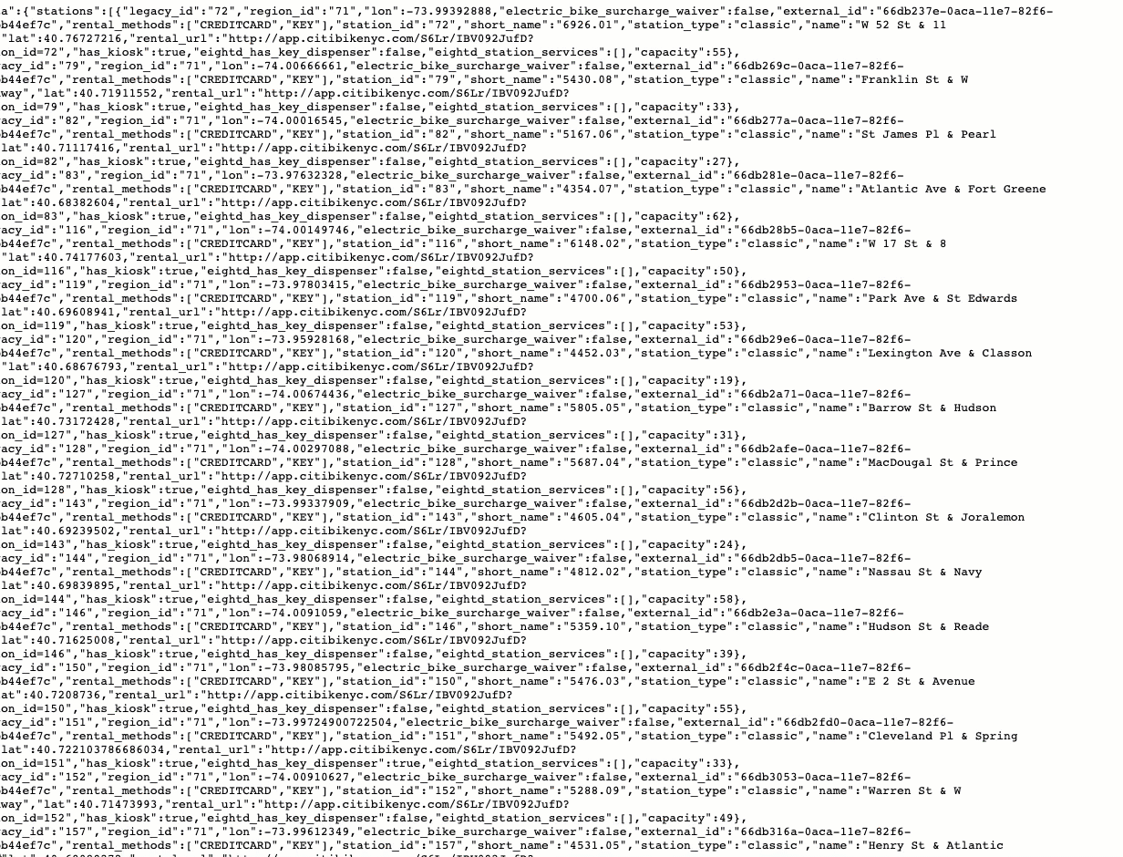
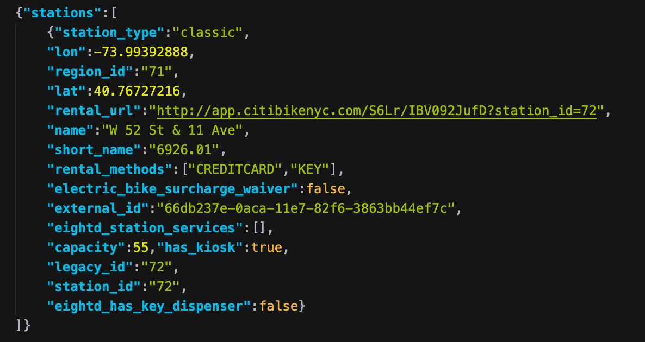
Introduce Citi Bike
Basic Version:
Citi Bike API Station Information Endpoint.
d3.json("https://gbfs.citibikenyc.com/gbfs/en/station_information.json", createMarkers);
One kvp (key value property) of the json.
Each marker is placed at the latitude and longitude returned by request.
When a marker is clicked, a popup appears displaying the station name and capacity.
These responses includes: name, station and capacity of each station.

Slide 12
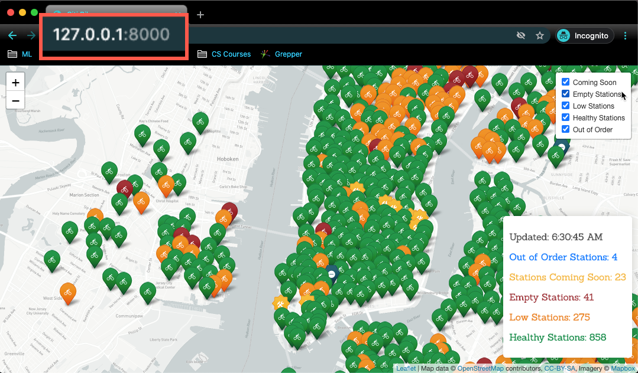
Introduce Citi Bike
Advance Version: Version:
Citi Bike API Station Information + Status Endpoint.
d3.json("https://gbfs.citibikenyc.com/gbfs/en/station_information.json", function(infoRes) {
d3.json("https://gbfs.citibikenyc.com/gbfs/en/station_status.json", function(statusRes) {
var updatedAt = infoRes.last_updated;
var stationStatus = statusRes.data.stations;
var stationInfo = infoRes.data.stations;
var stationCount = {
COMING_SOON: 0,
EMPTY: 0,
LOW: 0,
NORMAL: 0,
OUT_OF_ORDER: 0
};
This version groups markers into layers according to station status.
When a marker is clicked, a popup appears displaying the station name, capacity and bikes available.
These responses includes: name, station and capacity of each station.

Slide 13
Groups Do: Citi Bike
In this activity, you and your group will work with the Citi API to build a map of all the Citi Bike stations and their status.
30 Minutes

Slide 14
Group Do: Citi Bike
Basic Version Instructions:
Use the Citi Bike Station Information Endpoint to retrieve information about station names and locations. Take a moment to study the data sent back by the endpoint in your browser.
Each object in the stations array has station_id, name, capacity, lat, and lon properties.
The logic.js file in the skeleton folder contains coordinates that can be used to position a Leaflet map over New York City.
Create a function called createMap that will take in bikestations as an argument. This function will create both the tile layer and an overlay layer with the pins for each station.
Create a second function createMarkers that will take response as an argument.
Using the response from a future d3 call loop through the stations and create a marker to represent each station.
Give each marker a popup to display the name and capacity of its station.
In the createMarkers function pass the result the bike makers into the the createmap function as an layerGroup.
Perform a GET request using D3 to the Citi Bike Station Information Endpoint that will call the createMarkers function.
Remember to pass in your unique Mapbox token.

Slide 15
Group Do: Citi Bike
Advance Version Instructions:
After completing the Basic Version, write code to complete as much of the Advanced Version as possible.
Write code to perform a second API call to the Citi Bike Station Status Endpoint. Take a few moments to study the data being returned. In particular we are concerned with the station_id, num_bikes_available, is_installed, and is_renting.
Using the data retrieved from the second API call, try to add the following functionality:
Display the number of bikes available inside the popup for each marker.
Add a layer control and split the markers up into the following overlay layers:
Coming Soon: If a station is not installed.
Empty Stations: If a station has no bikes available.
Out of Order: If a station is installed but not renting.
Low Stations: If a station has less than 5 bikes available.
Healthy Stations: If a marker does not fall into any of the previous layer groups.
Utilize a Leaflet plugin to create different types of markers to represent each layer. For instance Leaflet.extra-markers, but you are free to use another plugin if you prefer.
Add a legend to your map to explain the different markers.
Deploy the app to Github Pages when complete.

Slide 16

Group Do: Citi Bike
Hints:
Make sure that you are running python -m http.server in the folder where your files are located. Since all the work is being done on the front end of your application, there will be no need to restart the router for changes made.
Some helpful links:
Leaflet Usage Example
Citi Bike Station Information API EndPoint
Leaflet Popup Doc
Citi Bike Station Status API EndPoint
Leaflet Layer Groups Doc
Leaflet Extra Markers
Leaflet Legend Doc

Slide 18

Project 2:
Visualize Me, Captain!

Slide 19

Tell
a
story
with data!

Slide 20
Project Requirements

Slide 21
Project Description
Your task is to tell a story data visualizations.
Focus on providing users an interactive means to explore data themselves.
Prepare a 10-minute presentation that lays out your theme, coding approach, data munging techniques, and final visualization.
You may choose a project of any theme, but we encourage you to think broadly.
You will have ample time in class to work with your group, but expect to put in hours outside of class as well.

Slide 22
Specific Requirements
Your visualization must include a Python Flask–powered API, HTML/CSS, JavaScript, and at least one database (SQL, MongoDB, SQLite, etc.).
Your project should fall into one of the below four tracks:
A custom “creative” D3.js project (i.e., a nonstandard graph or chart)
A combination of web scraping and Leaflet or Plotly
A dashboard page with multiple charts that update from the same data
A “thick” server that performs multiple manipulations on data in a database prior to visualization (must be approved)
Your project should include at least one JS library that we did not cover.
Your project must be powered by a data set with at least 100 records.
Your project must include some level of user-driven interaction (e.g., menus, dropdowns, textboxes).
Your final visualization should ideally include at least three views.

Slide 23
Schedule

Slide 24
Weekly Schedule
Day 1 (Today): Between now and Saturday, you will need to start brainstorming topics with your group and researching potential data sets. Your focus should center around:
Selecting a topic
Finding a data set
Finding inspiration
“Sketching” your ideal visuals
Creating a 1-page proposal
Day 2: You will need to create a 1-page proposal that includes:
A brief articulation of your chosen topic and rationale
A link to your data set(s) and a screenshot of the metadata if it exists.
3 or 4 screenshots of relevant, “inspiring” visualizations that frame your creative fodder
A sketch of the final design
A link to the primary GitHub repository you’ll be housing your work in
Day 3:
Project Work

Slide 25
Final Thoughts
Project week is a great time to tie up loose ends, both with your group and on your own.
If there are topics you’d like to review, shoot me and the TAs a message. We’re happy to do (recorded) extra review sessions for small groups during these weeks.
Good luck and have fun!

Slide 26
Questions?

Slide 27

Project 2
Kickstart

